Slide 1
SAGE Analytics
Tim kartawijaya
Johan sulaiman
Notes:
Hello everyone, my name is Tim Kartawijaya and I’m a Senior at Wheaton College, a liberal arts school in Illinois. Thanks to Johan Sulaiman, I’ve had the opportunity to be a contributor to this research, in particular in the analytics of SAGE. I’ll give more detail about that in a moment.

Slide 2
OUTLINE
1. Vision
2. Related Work
3. Implementation/Demos
5. Limitations and Future Work

Slide 3
Vision
Researcher: Does SAGE teach computational thinking (CT) concepts more effectively?
Baseline data: Scratch 1.0
How do we quantify CT concepts from a project?
Adopt rubric (PECT)
Automate scoring process in SAGE’

Slide 4
Vision
End goals:
Automate scoring for SAGE data
Automate scoring for Wild data (Scratch 1.0)

Slide 5
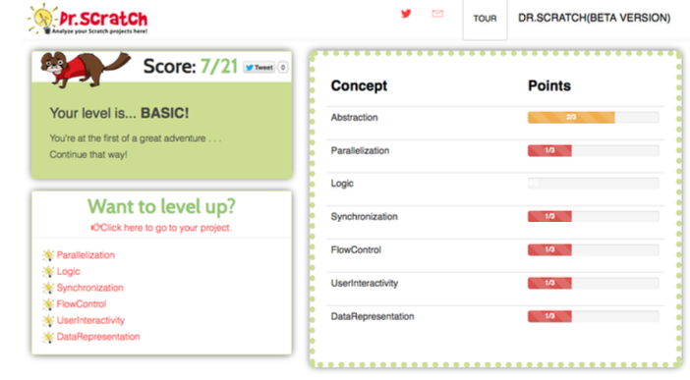
Related Work
Hairball: Python plug-ins
Dr. Scratch
Not much attention for Design patterns

Slide 6
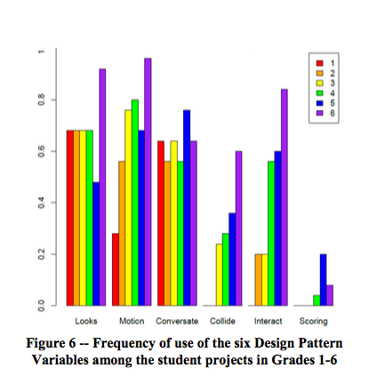
Related Work
Progression of Early Computational Thinking (PECT) Model
Incorporate Design patterns
Pilot-tested, results consistent with expectations

Slide 7
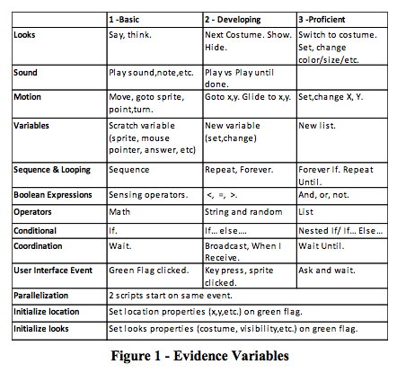
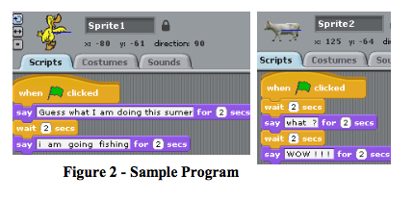
Related Work
Evidence Variables

Slide 8
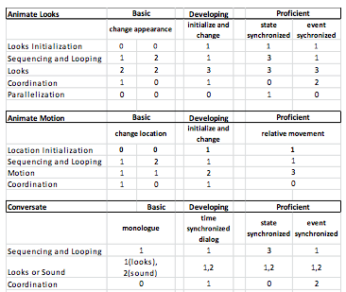
Related Work
Evidence Variables
Design Pattern Variables

Slide 9
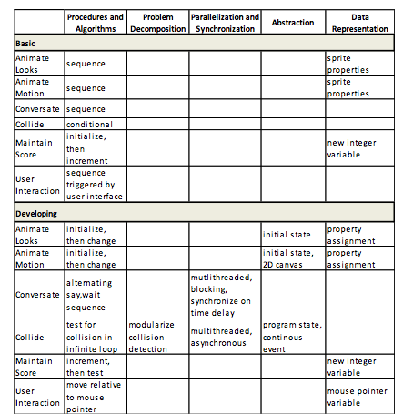
Related Work
Design Pattern Variables
Computational Thinking Concepts

Slide 10
Implementation/Related Work
Scratch Analyzer: extract Scratch project files to analysis-friendly format :
Scratch Extractor: .
sb2 files -> .se files

Slide 11
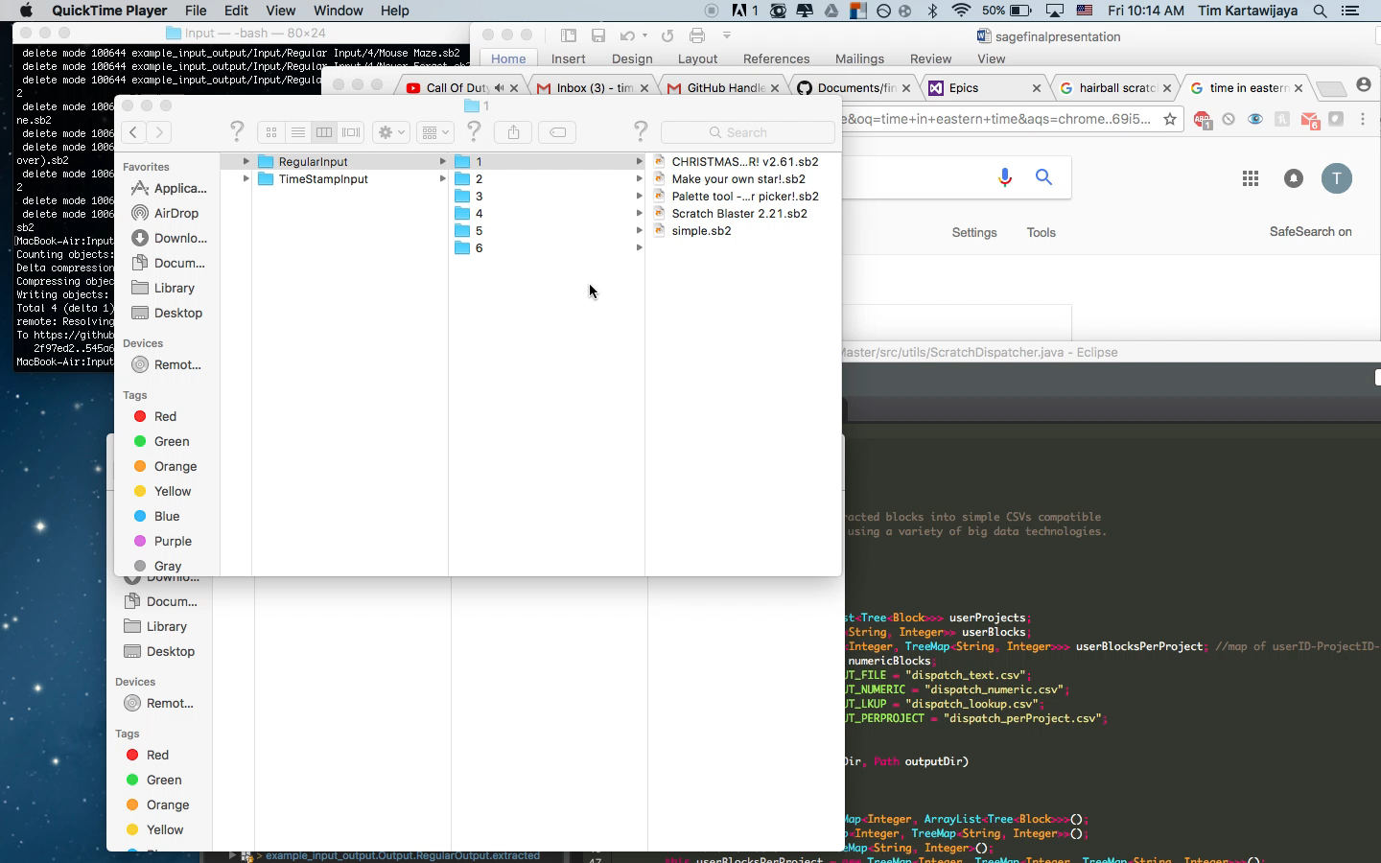
Implementation/Related Work

Slide 12
Implementation/Related Work
Scratch Extractor
Scratch Dispatcher:
.se files -> .csv files

Slide 13
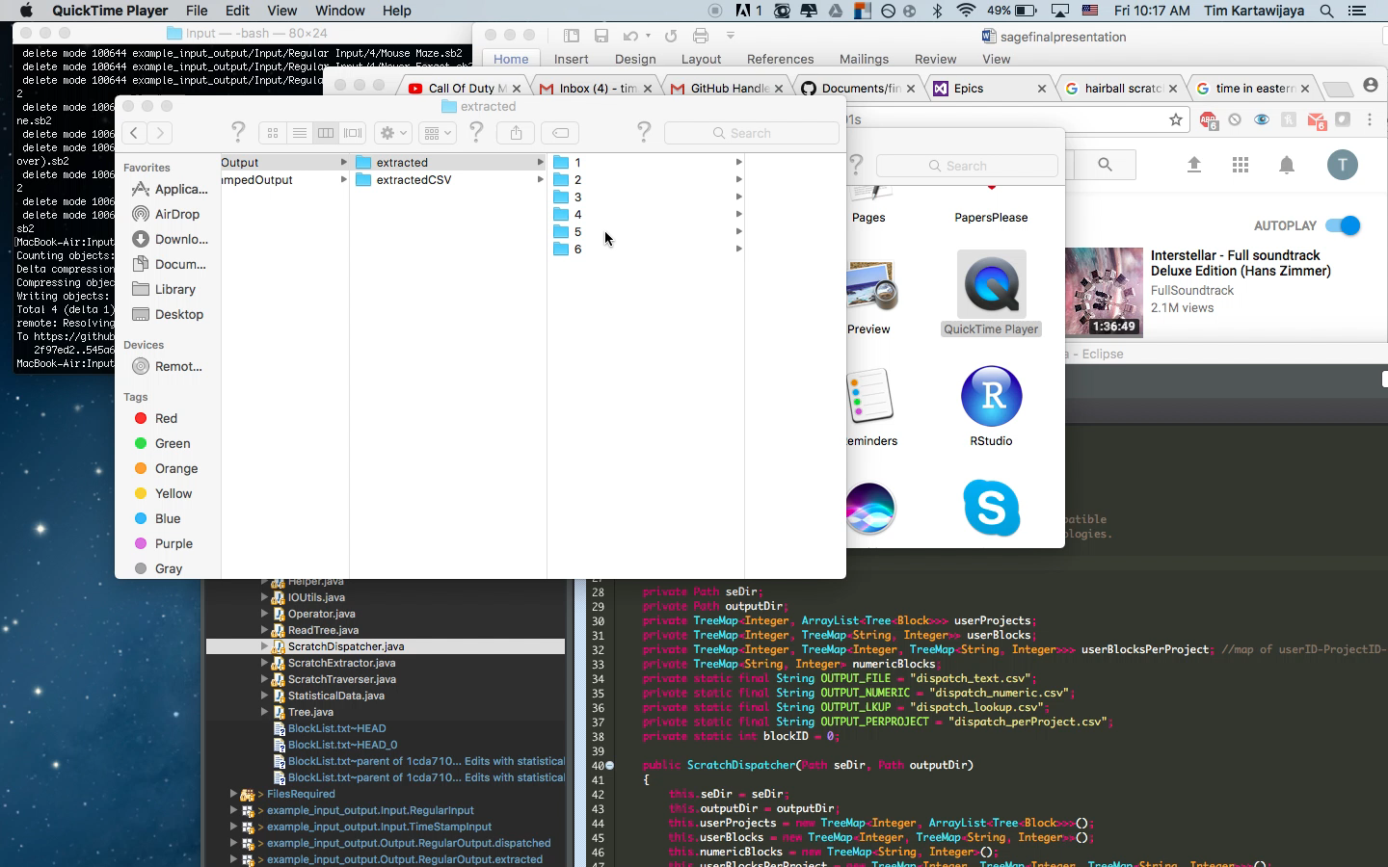

Slide 14
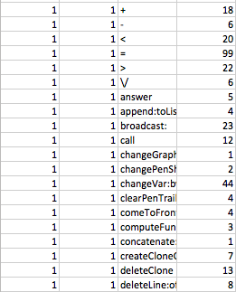
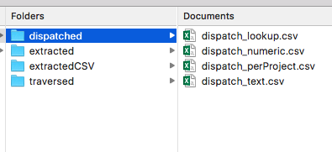
Implementation
UserID
ProjectID
Scratch Extractor
Scratch Dispatcher+ :
.se files -> .csv files + .csv perProject

Slide 15
Implementation
UserID
ProjectID
Scratch Extractor
Scratch Dispatcher+ :
.se files -> .csv files + .csv perProject

Slide 16
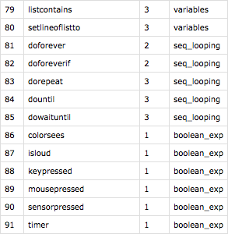
Implementation
ev_keys: look up table
Determine ev_score by project block name
Different names in Scratch version 2.0, easily add to look up table
look up table removes all : and _ symbols

Slide 17
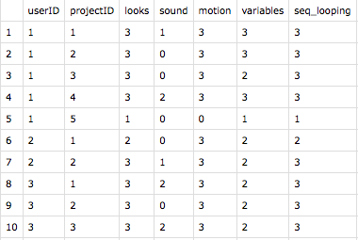
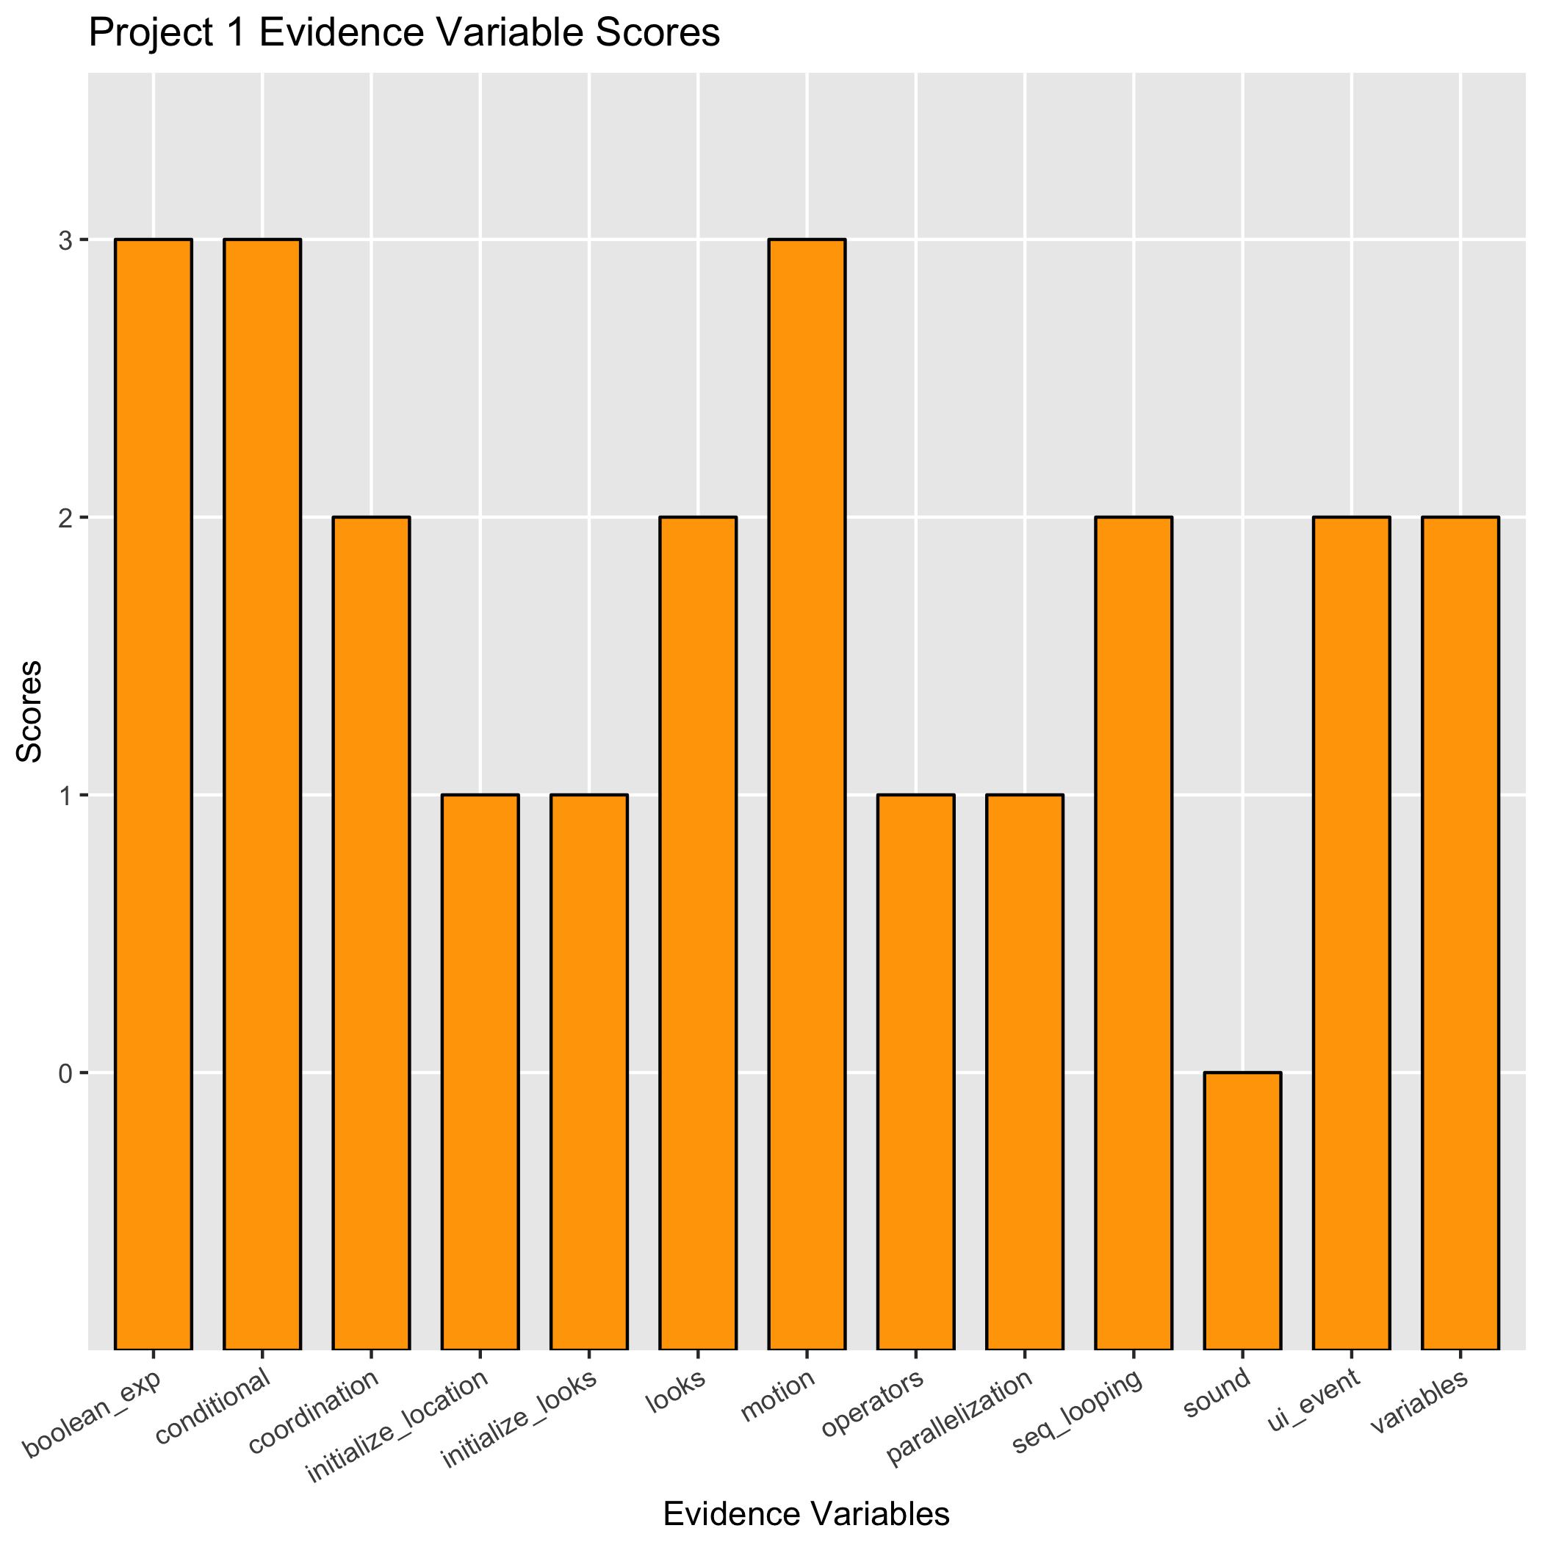
Implementation: SAGE
Analysis done by R
Use lookup data and more conditionals for special cases
Outputs:
.csv files, results and tests
Graphs of ev_score by project ID and student ID
notInclude.csv: what blocks are new in this version, compared with older blocklist

Slide 18
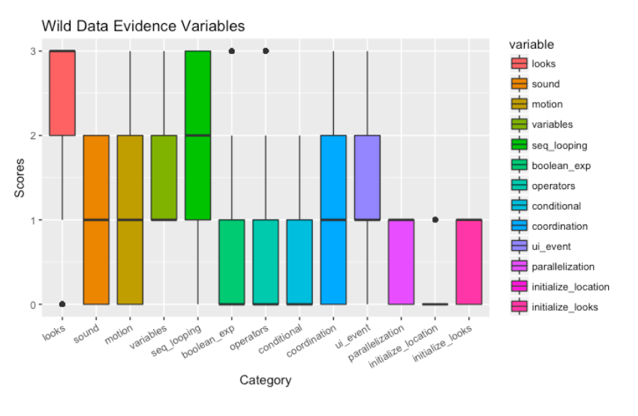
Implementation: Wild
Analysis done by R
Same concept, use lookup tables and if-else
Only first 1000 rows
In Scratch 1.0, basic evidence variables exist (looks) but not on operators and such

Slide 19
Demo

Slide 20
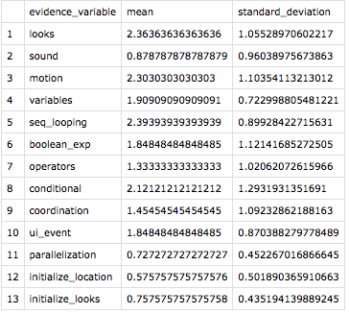
SAGE Statistics
(Added Functionality)
Statistics regarding overall competency in evidence variables are computed within the scripts
Both SAGE data and Wild data descriptive statistics can be computed

Slide 21
Limitations
Difficult to assess some evidence variables solely based on block placement (e.g. Nested If Else)
Assumption that all the blocks are cohesive and attached to each other

Slide 22
Future Work
Mapping to Design Pattern Variables and CT Thinking
Graphical display of scores on a student and class level
Project ID not by name but by order which it was processed
Integration to Scratch Dispatcher

